Slide 1
FEDERAL BUDGET 2005-2006
By
SYED SHABBAR ZAIDI, FCA
PARTNER
A.F. FERGUSON & CO.
The Institute of Chartered Accountants of Pakistan
KARACHI
on
June 13, 2005

Slide 2
TABLE OF CONTENTS
Conclusion
The Theme
Trust and Reliance
Misconception and Undue Fears
Realization of Realities or Back Tracking
Sales Tax on Services - Relief for the Manufacturing Sector
“Dubai or Korea”
The Bold Step - Zero Rating for Local Sales of Export Oriented
Industries
Refunds Again
Cross Matching - Documentation of Information
Federal Excise
Small Companies
The Task Ahead

Slide 3
CONCLUSION
A good and reasonable Budget
I wonder if there is any other solution ?

Slide 4

THE THEME
The Theme of this Budget is:
PUBLIC-PRIVATE PARTNERSHIP
+
SMALL AND MEDIUM SIZE ENTERPRISES, COUPLED WITH INCENTIVES FOR CORPORATIZATION
+
RELIEF FROM TAXES FOR EXPORT ORIENTED INDUSTRIES
This THREE PRONGED APPROACH is a revolutionary step. It is the result of progressive thinking where your institute has played an effective role. There is no time to critisize. We should look for solutions.

Slide 5
MISCONCEPTION AND UNDUE FEAR
As a nation we have to get rid of cynicism.
In 1996, when VAT was implemented in full scale, in my first detailed deliberation on VAT, at that stage, I said; ‘MIND THE GAP’, Now, I still say the same thing, however, over ten years’ progressive fiscal policies have led me to belief that the ‘GAP’ will always be filled by ‘GROWTH’, if policies remain correct.
There is no space for new taxes. Overall incidence should be reduced. GDP growth will result in increased taxes.
Thus Rs 690 Billion is not a big task. INSHA-ALLAH it will be achieved.

Slide 6
TRUST AND RELIANCE-
FACTS AND FIGURES
 | RUPEES IN BILLION
 | 2004-2005 | 2005-2006 | INCREASE
Custom Duty | 113.90 | 121.200 | 7.30
Sales Tax | 239.00 | 294.00 | 55.00
Federal Excise | 54.400 | 59.40 | 5.00
TOTAL | 407.30 | 474.60 | 67.30
There is no new tax. Increase in revenue is expected from economic growth. Expected Revenue from growth is around Rs 110 billion. In effect there is a reduction in taxes and duties.

Slide 7
TRUST AND RELIANCE
(Cont’d)
FACTS AND FIGURES
In Pakistan there is no ‘Budget Deficit’. There used to be ‘Trust Deficit’ which has substantially reduced. Trust Deficit between tax payers and tax collector. Government and the people.
Last year also there was no new tax and Pakistan (People and Government of Pakistan) achieved the target through growth. In the following year also the same trend will (INSHA-ALLAH) be achieved.
Some of the engines of growth were:
  Agriculture
  Textile and other export oriented sector
  Service Sector
  Other large scale manufacturing
Out of the same, First three do not effectively contribute for indirect taxes. So what is the fear for future collection.

Slide 8
REALIZATION OF REALITIES OR BACKTRACKING
There were successes and problems in VAT implementation. However, growth over the ten year period from 1996 to 2005 has been exponential; increase from 70 billion to Rs 300 billion i.e. 500 per cent .
In 2004 budget, major procedural irritants were removed.
The question after reviewing 2005 budget is
‘ARE WE BACKTRACKING’

Slide 9
REALIZATION OF REALITIES OR BACKTRACKING
(Cont’d)
There is no backtracking in principle. However, there have been certain steps where a ‘tilt’ in progressive approach has been felt. These are:
  Abolition (zero–rating) of sales tax on local sales of export oriented industries;
  Extension of levy of tax at retail price by manufacturer for further items; and
  Minimum value addition concept introduced in 2004.

Slide 10
REALIZATION OF REALITIES OR BACKTRACKING
(Cont’d)
  As a policy measure all these actions should not have been there, however there are certain ground realities, which have led to the steps above.
  These include the issues of ‘RELEASE’ and ‘GENUINENESS’ of refunds.
  Refunds were around Rs 50 Billion. The action undertaken is in line with the principle of ‘Level Playing Field’ for all exporters.
  Rs 50 billion will now be available for new ‘INVESTMENT’.

Slide 11
SALES TAX ON SERVICES - RELIEF TO MANUFACTURING SECTOR
Employment growth and poverty alleviation is directly related to growth in the manufacturing sector. Now a substantial revenue base has been achieved.
Now, there is a need to provide certain relief to the manufacturing sector.
Zero rating for the local sales of exports industries is a step in that direction.

Slide 12
SALES TAX ON SERVICES - RELIEF TO MANUFACTURING SECTOR
(Cont’d)
There has to be equity for the incidence of tax in relation to ‘Manufacturing Sector’.
Incidence of indirect tax on manufacturing sector be reduced and certain burden has to be shared by the service sector.
As a policy measure it needs to be appreciated that extension of VAT on services has not been given due priority. This matter is getting confused. In the larger national interest, intra-provincial issues on this matter have to be sorted out.

Slide 13
‘CATCH 22’ – DUBAI OR KOREA’
CUSTOM DUTY AND SURVIVAL OF LOCAL INDUSTRY
On import duties structure we are in ‘Catch 22’ situation. On one hand there is an issue of ‘Smuggling Prone’ items and on the other hand there is the problem of ‘Survival of Local Industry’.
Other than the above, there are ‘Chinese Goods’.
Small scale local industries are closing down. Now a relief has been provided to export-oriented industries.
This issue directly related to the issue of employment and poverty alleviation.
This has nothing to do with WTO. The issue relates to ‘cascading’ and ‘level playing field’ against imports
There is need for a comprehensive ‘Tariff Study’.

Slide 14
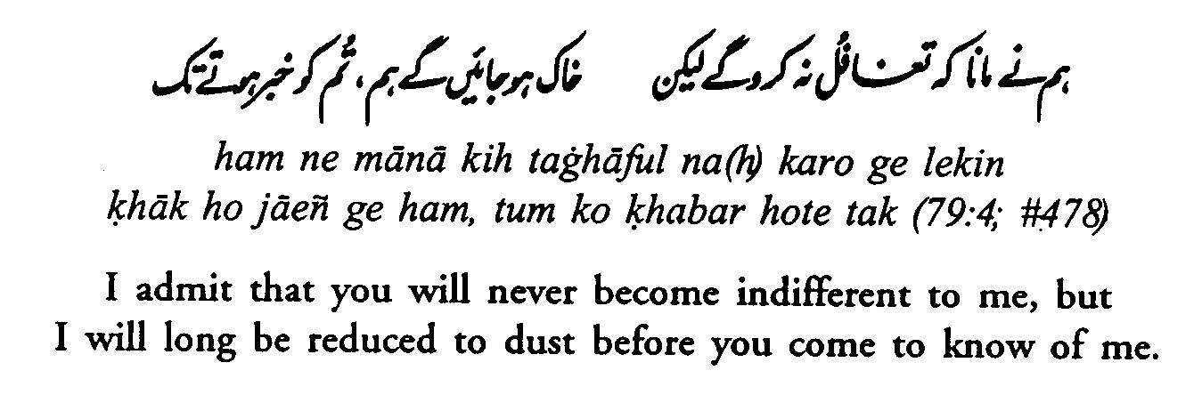
‘CATCH 22’ – DUBAI OR KOREA’
CUSTOM DUTY AND SURVIVAL OF LOCAL INDUSTRY
Trickle down effect will take time ….

Slide 15
THE BIG CHANGE- ZERO RATING FOR LOCAL SALES OF EXPORT ORIENTED INDUSTRIES
The Facts
Entire chain of local sale of the following export oriented industries has been zero-rated. No output tax, input, if any, refundable, including utilities:
  Textile and Textile Articles
  Leather and Articles thereof
  Carpets
  Sports Goods
  Surgical Goods
Zero-Rating is effective from June 6, 2005 (SRO 535)

Slide 16
THE BOLD STEP - ZERO RATING FOR LOCAL SALES OF EXPORT ORIENTED INDUSTRIES (Cont’d)
Basic raw materials for such industries have also been zero rated.
It needs to be clearly understood that this list can never be complete as otherwise there will be acute misapplication.
For remaining items refunds are available.
Under SRO 528 no exporter will be allowed refund on stocks after June 30, 2005. Date needs to be revised.

Slide 17
THE BOLD STEP - ZERO RATING FOR LOCAL SALES OF EXPORT ORIENTED INDUSTRIES (Cont’d)
As local sales have been zero-rated therefore a 3 (per cent) retail tax has been levied on retailers of products of such export oriented industries. However, this will only apply to retailers where the turnover exceeds 5 million. In effect this means exemption for consumers.
Thus following consumer goods can become cheaper:
  Textile
  Leather etc.

Slide 18
AMNESTY - FOR ALL PAST LIABILITIES
‘One time’ amnesty for all additional tax and penalty payable, if the principal liability is voluntarily deposited by June 30, 2005.
It has yet to be clarified that this amnesty will also be applicable where principal amount has been paid (SRO 520).

Slide 19
REFUNDS AGAIN
The right to ‘Carry Forward’ excess input tax to the following period or periods abolished. Now full amount is required to be refunded.
This means ‘refunds’ again.
This amendment needs to be re-examined.

Slide 20
SALES TAX AT RETAIL PRICE
This is a deviation from VAT, it should be avoided.
Scope of levy of sales tax on retail price by the manufacturer under the Third Schedule extended to consumer items like soap, detergent, perfumery / cosmetics, shaving cream, toothpaste, shampoos, tea, etc.
This amendment in relation to imported items of same needs to be re-examined.

Slide 21
CROSS MATCHING –
A STEP TOWARDS DOCUMENTATION
A very positive approach. A step towards documentation.
Special procedures to be introduced for prescribing summary of purchase and sales for cross-matching of invoices for all sectors except those which have been subjected to zero rate of sales tax. Such details to be provided by 15th of the following month.

Slide 22
FEDERAL EXCISE
Central Excises Act, 1944 and the Central Excises Rules, 1944 substituted with effect from July 1, 2005 with the Federal Excise Act, 2005 and Federal Excise Rules, 2005 respectively.
Under the new Act and Rules traditional licensing and warehousing systems have been abolished.
Adjustment of excise duty paid on inputs used in the manufacture of goods on which excise duty is payable or has been paid, except for beverage concentrate. Excise duty paid on concentrate is not adjustable.
Whole system to operate on self-clearance, self-assessment and self compliance basis. Excise staff posted in excisable units therefore withdrawn.

Slide 23
SMALL COMPANIES
After a long deliberation, in order to provide boost to corporatization, documentation and relief from taxes a well laid down strategy has been adopted for ‘Small Companies’. The definition of such a company can be debated, however, as a concept, there could not be a second view.
Now, it is the role of ICAP to provide, a workable mechanism for accounting, reporting, and audit of such companies. It needs to be considered that it is a long-term strategy. ICAP should act as a ‘conduit’ in achieving the ultimate goal. It will greatly boost the profession.
2005-2006 Budget will always be seen as a historical document for this change.

Slide 24
TASK AHEAD
On the policy side, the suggestions and the steps undertaken are on right direction. There is a need for continuation and consistency of policies.
There could be some difficult time in between, however, the end and the way towards the end has been rightly identified.
When we have decided to make this country an enlightened developed state then there could be some difficult task which this nation has to overcome.
What we are doing is for this nation and our future generations.

Slide 25


Slide 26
I thank you

